Slide 1
Interference and diffraction
Experiment

Slide 2
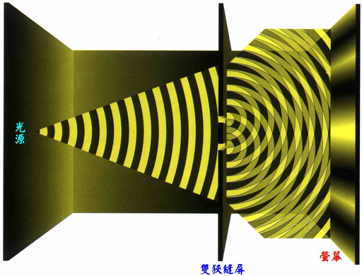
Object
Using laser diode mapping the double-slit interference and single-slit diffraction image
To understand the double-slit interference and single-slit diffraction principle
Light source
AEEA 天文教育資訊網

Slide 3
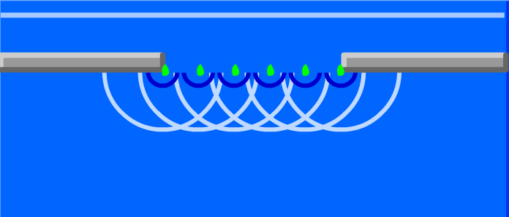
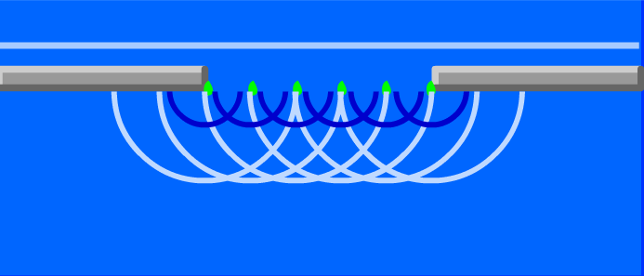
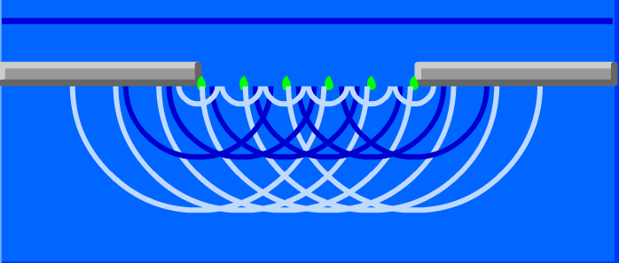
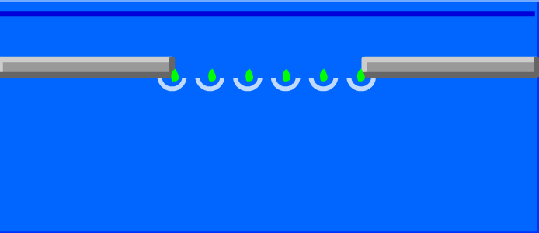
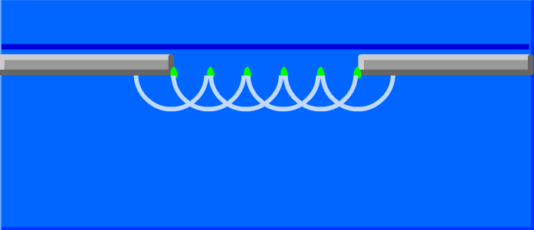
Huygens principle
1. Each point on the wave front can be regarded as the new point wave source and as the center or the center of the sphere. Each of its generates the circular wave or spherical wave.
2. And then after a certain time t, the new wave emitted through a distance r = v t, the line or plane tangent to the circular wave or a spherical wave generated (referred to as envelope or envelope surface), namely, a new wave front.
4
2
5
6
1
3

Slide 4
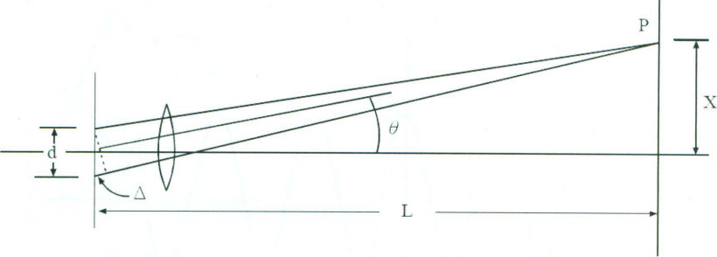
double-slit interference
Phase leading wave
Dimming parallel light, intensity I₀
Phase backward wave
optical path difference
Point P electric field obtained by the graphical method, Intensity
Optical path difference is ,so
At δ=2m π and (2m+1) π are constructive and destructive interference maxima

Slide 5
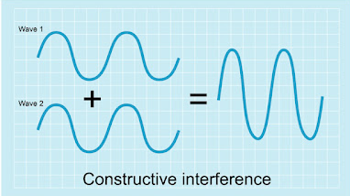
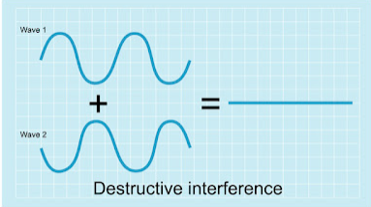
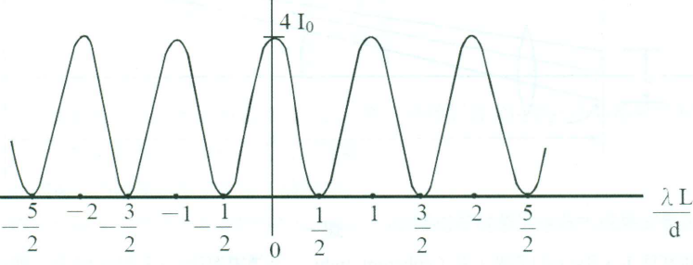
double-slit interference
At δ=2m π and (2m+1) π are constructive and destructive interference maxima
Using mapping the illuminating distribution
化學原理啟迪300
Extra from Wiki

Slide 6
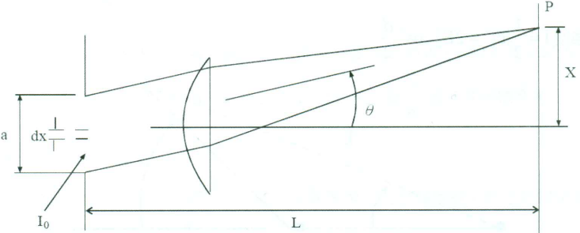
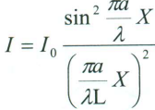
single-slit diffraction
The width a of the slit in brightness I₀ the incident light is divided into n units
a
N unit
Point P, the optical path difference between the two adjacent units is Phase difference
The electric field E and the intensity of the point P obtained by the graphical method

Slide 7
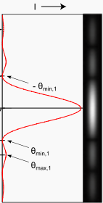
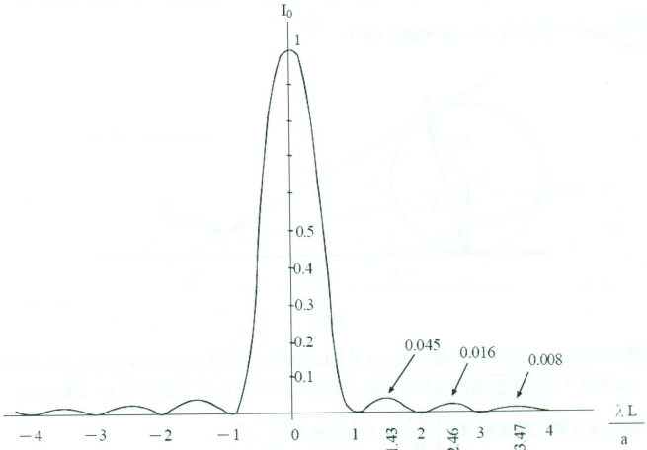
single-slit diffraction
Using Eq. , X is the x-axis, I is the y-axis, plotted illuminating distribution FIG.
Wikipedia

Slide 8
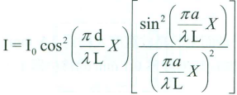
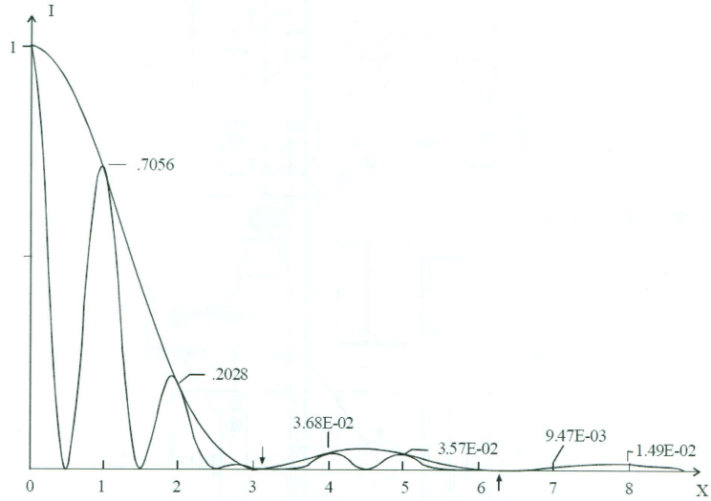
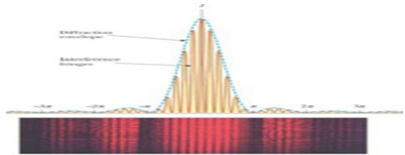
Double-slit interference with the effects of the single-slit diffraction
Double slit is composed by two single slit, double slit interference must be accompanied by the single-slit diffraction effects. Mixed by both light intensity can be the sum of the light intensity
a : Signal slit width d : Two slit spacing

Slide 9
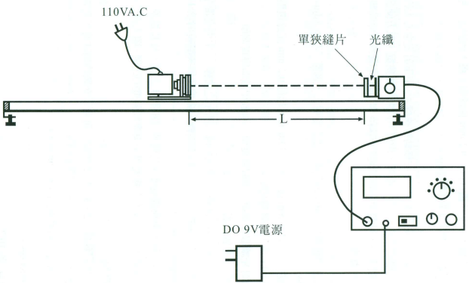
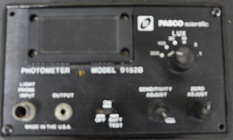
Apparatus
Optical amplifiers
Laser Diode
Optical fiber holder

